Slide 1
group memebers
Furtuna G/Slassie mit/ur/046/12
Betelhem Haftu mit/ur/159/12
Meles Mengesha mit/ur/ 298/12
Ayda Angesom mit/ur/ 158/12
Yorkabel Ngatu mit/ur/190/12
Meles H/Slassie mit/ur/101/12
Makda Haile mit/ur/231/12
Yemane G/Michael mit/ur/273/12
Michiale Adhanom mit/ur/166/12

Slide 2


Classification Report – Bank Marketing Dataset
This presentation covers building a Random Forest model to predict bank term deposit subscriptions.
by Meles Haileselassie

Slide 3

Project Introduction
Objective
Significance
Predict client subscription to term deposits using supervised learning.
Enhances bank marketing, reduces contact costs, improves campaign efficiency.
Dataset
From UCI, sourced from Portuguese bank marketing campaigns.

Slide 4
Exploratory Data Analysis (EDA)
Dataset Overview
Key Observations
11,162 records
Age range: 18–95, mean ~41
16 predictors + 1 target
Skewed balance; some negative
Mixed categorical and numerical features
Contact duration varies widely
Target distribution slightly imbalanced (~53% no, 47% yes).
No missing values detected
Most clients contacted by cellular, majority married with secondary education.

Slide 5
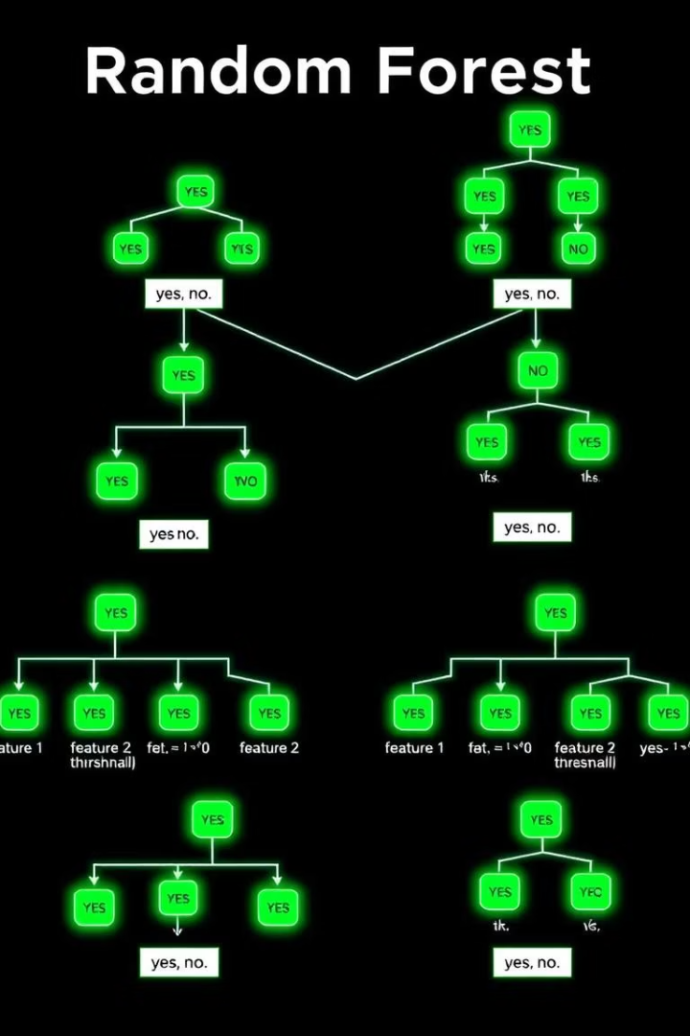
Methodology
Data Preprocessing
Feature Selection
All original features retained except duration excluded for real-time deployment.
Label encoding for categoricals; standard scaling of numerical features.
No missing data imputation.
Model Choice
Random Forest classifier chosen for robust handling of mixed data and interpretability.
Default 100 trees, no complex tuning.

Slide 6

Model Training
Data Split
Reproducibility
80% training, 20% testing with stratified sampling to preserve class distribution.
Random seed fixed at 42.
Baseline Model
Trained without hyperparameter tuning, providing performance benchmark.

Slide 7
Evaluation and Results
Performance Metrics
Top Features
Accuracy: 85.31%
Duration (excluded for deployment)
Precision (yes): 83%
Previous campaign outcome (poutcome)
Recall (yes): 87.%
Account balance
F1-score (yes): 85.5 %
Days since last contact (pdays)
Age

Slide 8




Conclusion and Next Steps
Summary
Random Forest model achieved strong accuracy and balanced metrics.
Challenges
Feature leakage (duration), mild class imbalance present.
Future Improvements
Hyperparameter tuning and alternative models
Address imbalance with resampling (SMOTE)
Exclude duration for deployment scenarios

